Slide 1
KP INACCURATE DISPENSES ANALYSIS
Analysis by:
Kibet Evans

Slide 2
Issue Definition
Data collection
What We Know
Root causes brainstorm
Next steps

Slide 3
Issue Definition
112 issues recorded by NOC between 1st Jan-21st March 2020 where customers complained of receiving less fuel than they were billed during purchase.
The comprehensive list of these freshservice tickets are listed in KP inaccurate dispenses sheet.
Objective:
To determine the root cause for these inaccurate dispenses and propose appropriate recommendations.

Slide 4
Data Collection
Data was collected for the most recent 65 out of 112 issues reported.
It involved identifying;
Whether canister is new or old
Frequency of occurrence of the issue
Whether other customers were affected in the same KP.
Dispense flow rate recorded for that customer during incident vs before and after, also trends for other customers in that KP.
Records from maintenance team intervention if any.
Comprehensive data: KP inaccurate dispense - column D

Slide 5
What We Know
Both new canisters and old canisters are encountering the inaccurate dispense issue.
New canisters - those that have <5 dispenses since canister purchase
Old canisters - those that previously had multiple successful dispenses
Issues are spread across the network on different KPs with few repetitive cases on a single KP.
Current workaround:
Customers are compensated based on difference between requested amount vs photos showing dispensed volume, and issues are validated through tank level trends.
Canisters with reproducible issues are retrieved and replaced.

Slide 6
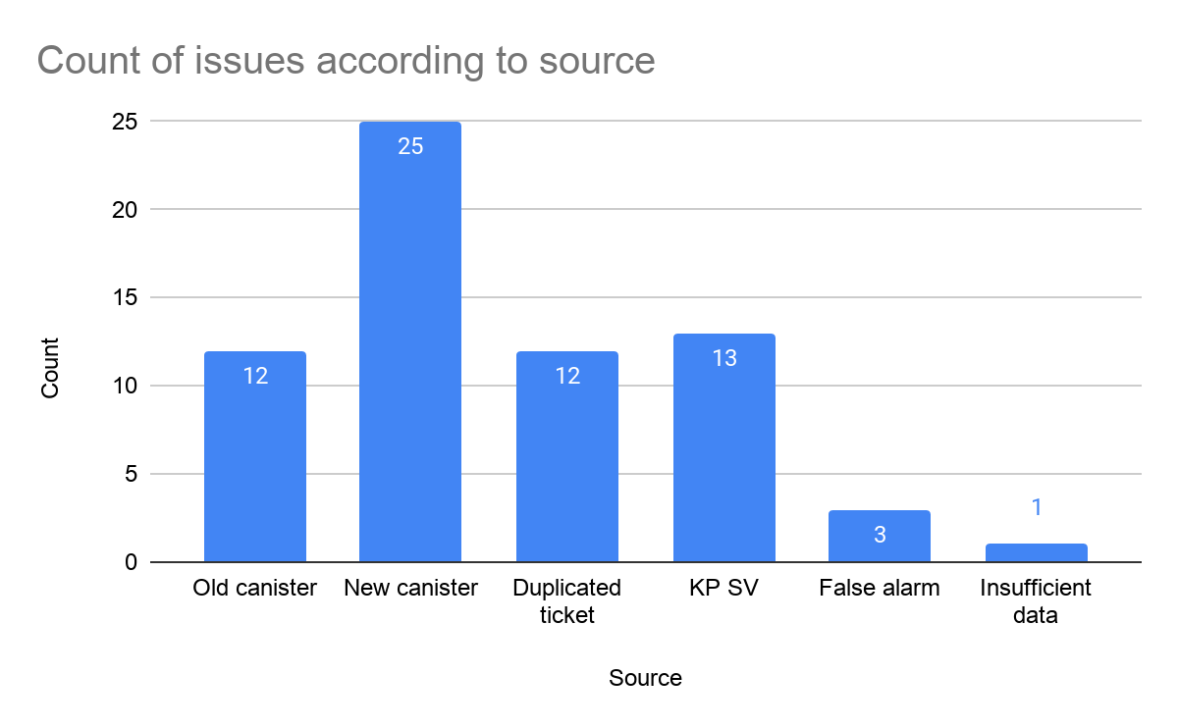
Current State Analysis
Data collected on each issue led to identification of probable cause for the issue, i.e.
New Canisters
Old Canisters
KP Smart Valve (SV)
False alarm - KP went off during dispense, data collected shows normal flow rate, no photo was available to indicate fuel loss, other customers did not have inaccurate issue and the victim canister did not have previous and subsequent issues.
Insufficient data - details were not provided regarding the affected customer and flow rate trends did not show any anomaly

Slide 7
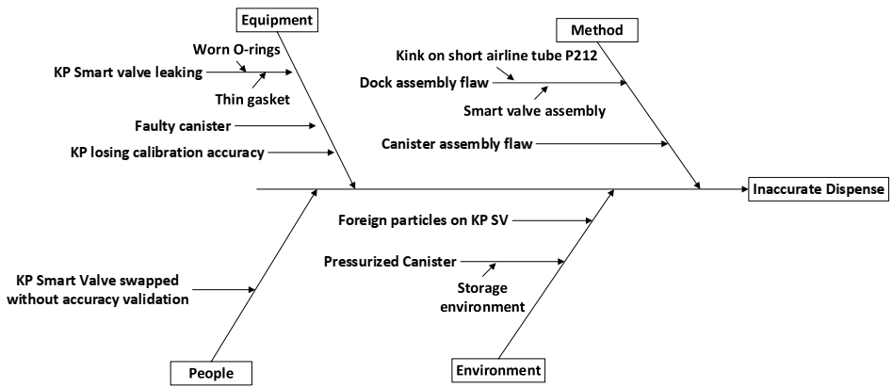
Cause and Effect Diagram

Slide 8
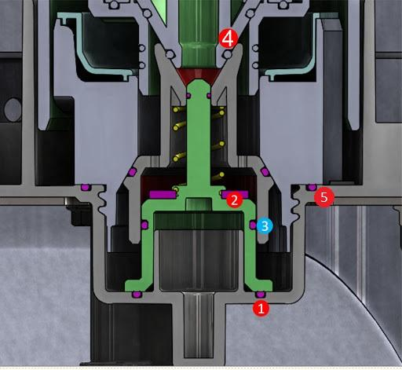
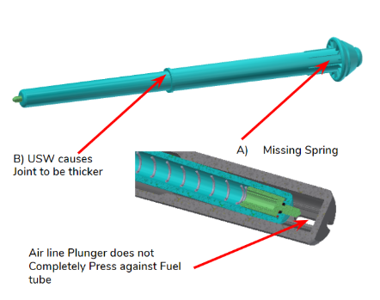
Root causes brainstorm cont’d
Secondary causes of leakage in KP SV
Root cause of Faulty canister:
Leaking canister - fuel pours out freely and leaks into the airline
Valve actuation problem
Airline opening problem - thick USW
1: 30x2mm O-ring displaced - cyclic rotation during docking
5: 53x2mm O-ring displaced
2: Thin gasket
4: Canister O-ring displaced/worn out

Slide 9
Root Cause Prioritization Matrix
PRIORITIZATION MATRIX
 | Possible root cause | Probability of occurrence | Severity Level | Ease of detection | Cumulative scale | Recommendations
1 | Faulty canister | 4 | 5 | 4 | 80 | Test canister dispense flow rate before dispatch. Test KP will have range of expected flow rates and rejection criteria for faulty canister.
2 | KP Smart valve leaking | 3 | 4 | 4 | 48 | KP Leakage Investigation
3 | KP SV assembly flaws | 2 | 5 | 4 | 40 | Review test criteria & procedure for SV testing after assembly or rework
4 | KP Smart valve swapped/repaired hence needing re-calibration | 4 | 4 | 2 | 32 | There is an existing calibration validation process for SV field replacement.
5 | Kink on short airline P212 | 2 | 4 | 3 | 24 | Introduce inspection of both airline and fuel line kinks in assembly QC checklist and after SV repair
6 | Foreign particles on KP Smart valve | 3 | 4 | 2 | 24 | Introduce this check in CS resolution steps & troubleshooting procedure.

Slide 10
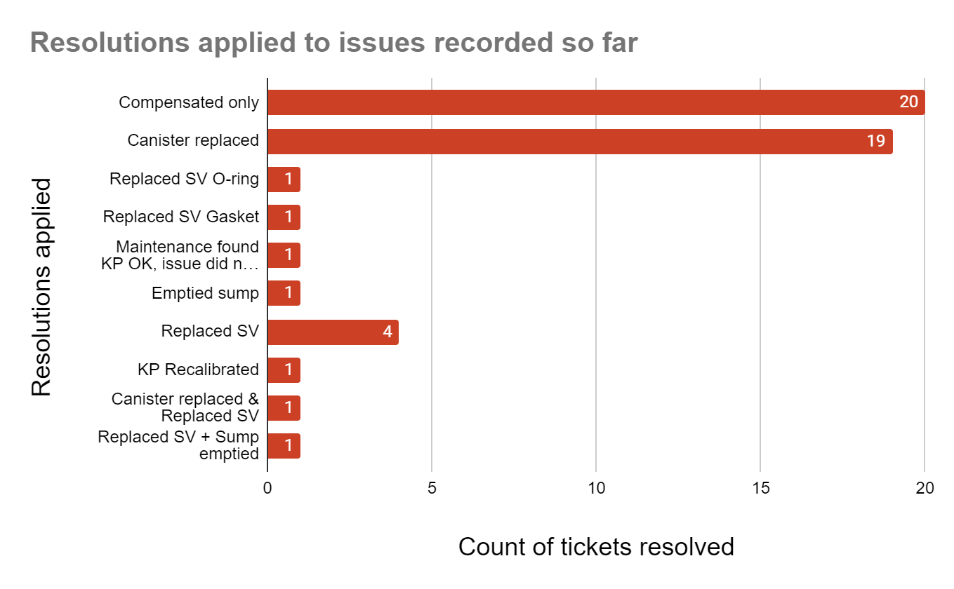
Analysis
Resolutions currently applied to the analyzed tickets were as follows;
Credit compensation only
Canister replacement accompanied with credit compensation
KP Smart valve(SV) o-rings replacement
Replacing thin SV gasket with thicker one of 3mm
Maintenance visited KP, tested and found no issue hence did not apply any resolution.
KP rockwool/sump emptied

Slide 11
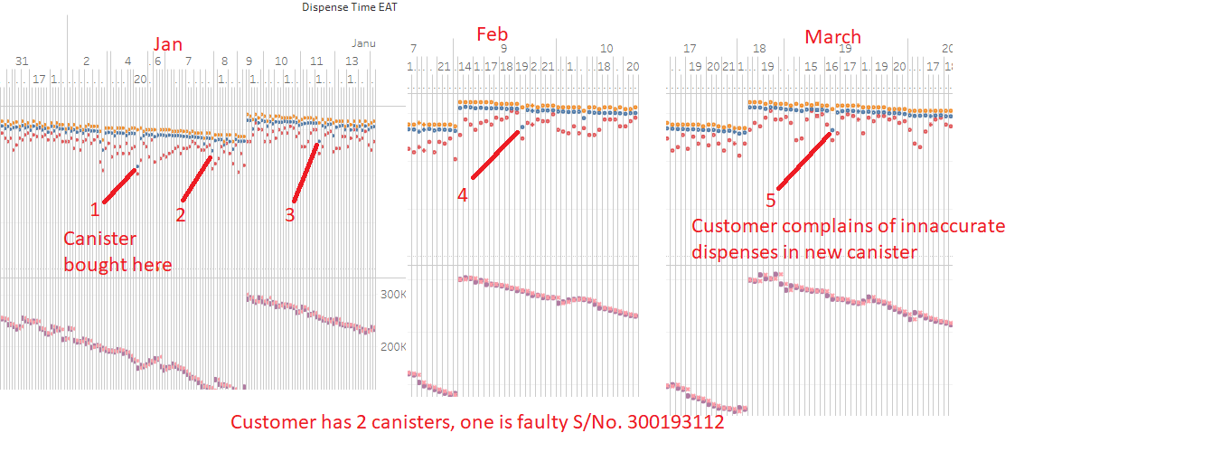
New canisters
Avg flow rate for victim customer uniquely dropped lower than others but within threshold.
Behaviour lasted for 3 months

Slide 12
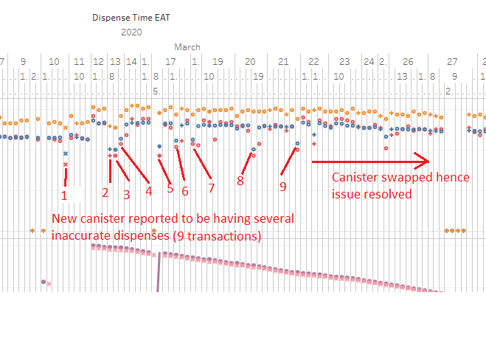
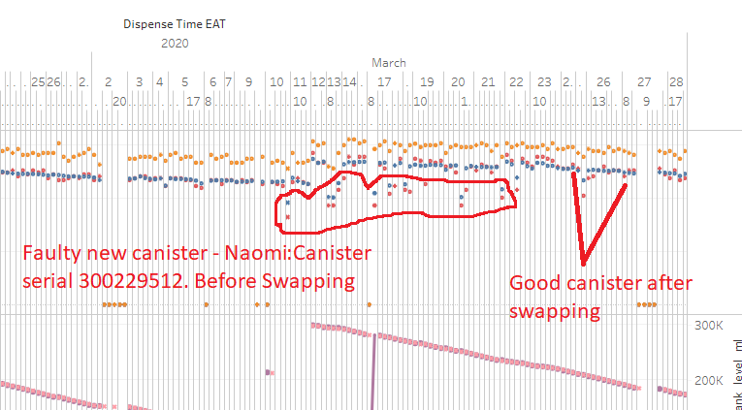
New canisters cont’d
Issue persists until canister is swapped

Slide 13
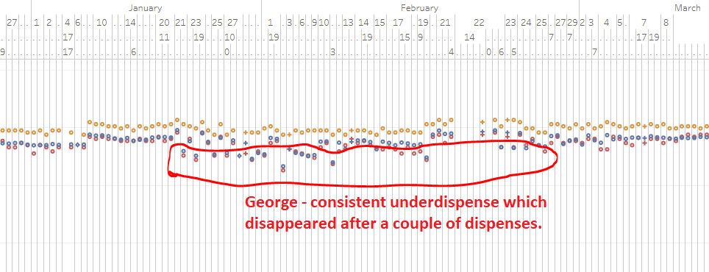
New canisters cont’d
Persistent dropped flow rates,
Issue disappears without intervention after a while - suspected thick USW joint in canister which smoothened after several dispenses. Thick joint causes incomplete airline valve actuation hence restricting fuel flow.

Slide 14
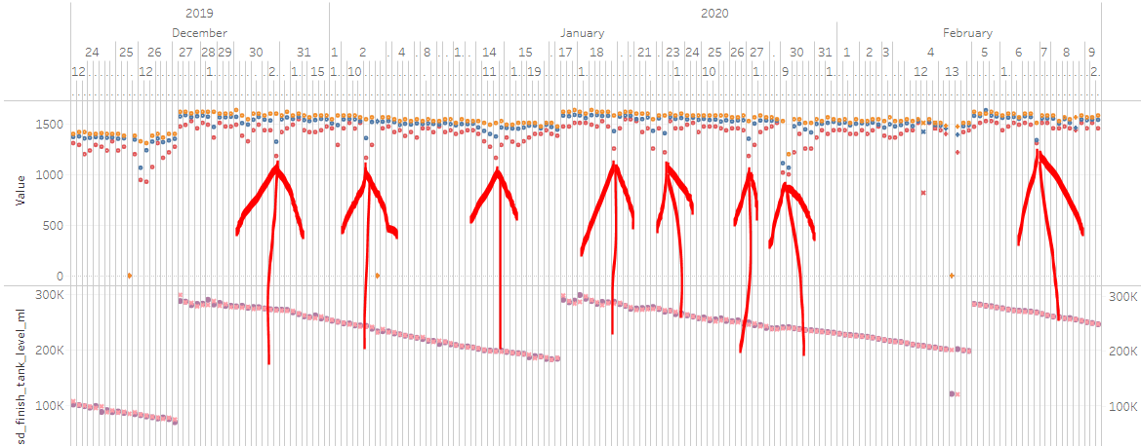
New canisters cont’d
Persistent dropped flow rates for 2 customers observed unlike other customers.
1st customer - canister replaced | 2nd customer - flow rates resumed normal after 2 months with no intervention. Customer reported issue in Jan, but canister was not replaced.

Slide 15
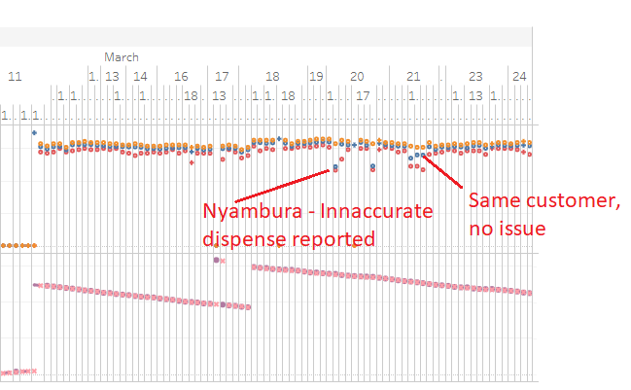
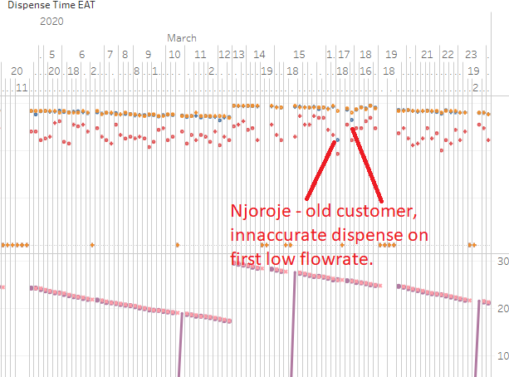
Old canisters
Issue encountered once by customer, characterized by dropped flow rate during dispense - suspected foreign particle in KP & Displaced O-ring1 during docking?
Some canister issues are KP specific e.g. Ticket 11371

Slide 16
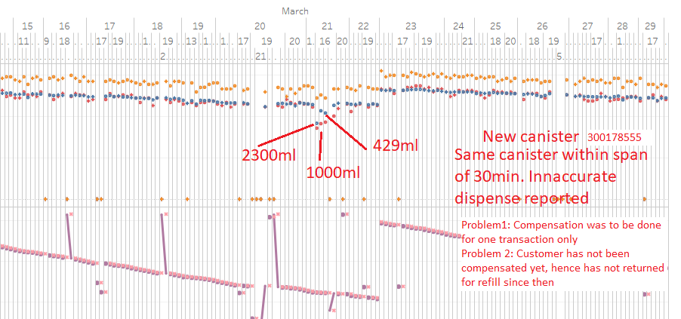
New canisters cont’d
Customer dispenses more than 2.3 litres in several consecutive dispenses all within a duration of 30mins in same KP. Compensation was scheduled for one transaction only instead of 3. Customer has never returned to refill in any KP since incident. - Suspected leaking canister .

Slide 17
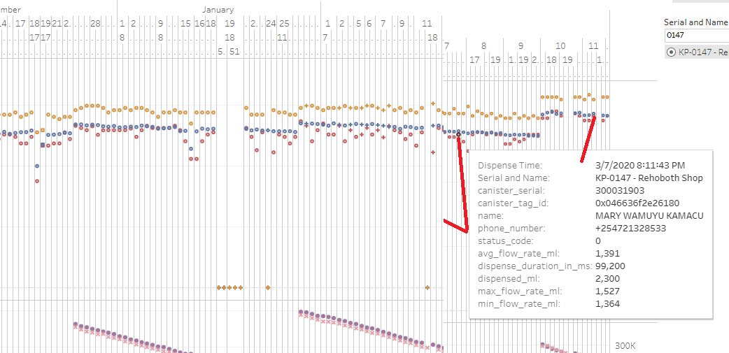
New canisters cont’d
Issue encountered on some incidents, characterized by normal flow rate - suspected slow canister/SV leak.

Slide 18
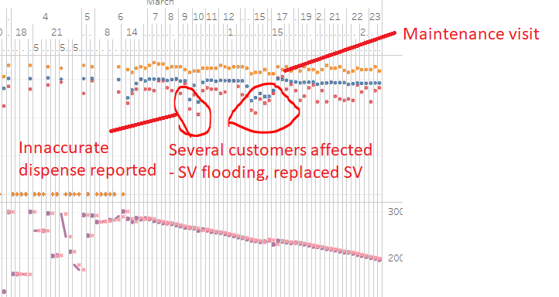
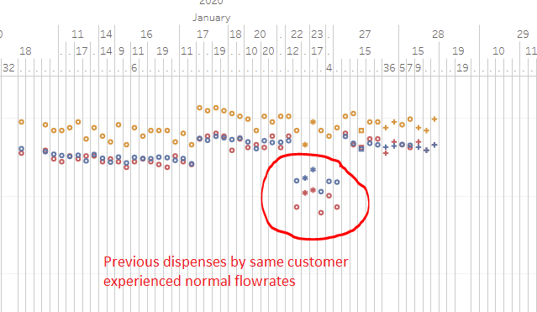
KP Smart valve
When encountered, issue affects several customers. - suspected dislodged O-rings
Issue 1: Maintenance changed SV | Issue 2: Maintenance found no issue with KP and changed nothing. root cause must be related to KP SV but still unclear which specific part

Slide 19
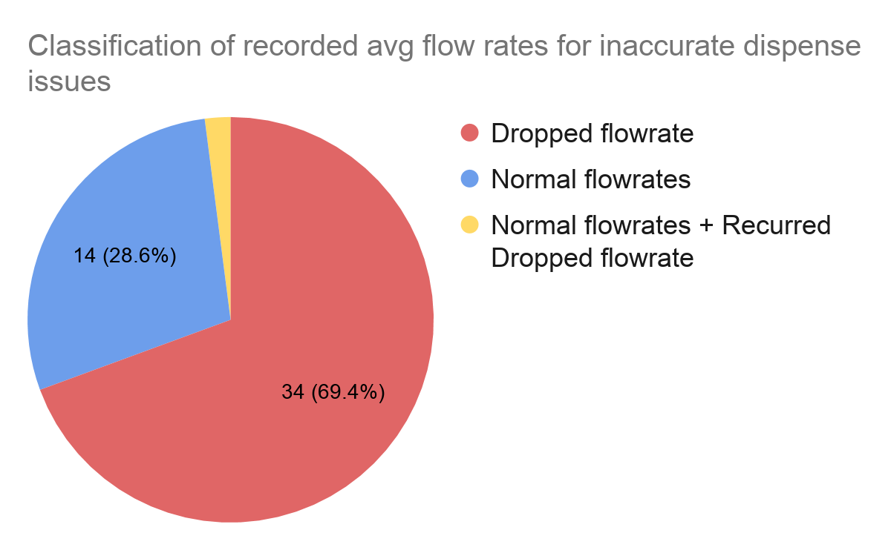
Analysis cont’d
69% inaccurate dispense issues exhibited a lower value of average dispense flow rate compared to other customers. This parameter can therefore be included as a validation check for an inaccurate dispense issue.
Unusually dropped dispense flow rates for canisters can also be monitored and flagged by NOC.

Slide 20
Next steps
Troubleshooting guide for inaccurate dispense - Evans
Repair guide and repair process for retrieved SV - Done
Review QC process for new canisters before dispatch to reduce issues related to new canisters - Done
Review Repair process for retrieved canisters - Cooker service team
Train maintenance team on resolving SV related issues and reporting methodology - on going

